Slide 1
Robust fine-tuning of zero-shot models
CVPR’22 (oral)
AIV1 Sato
https://arxiv.org/abs/2109.01903

Slide 2
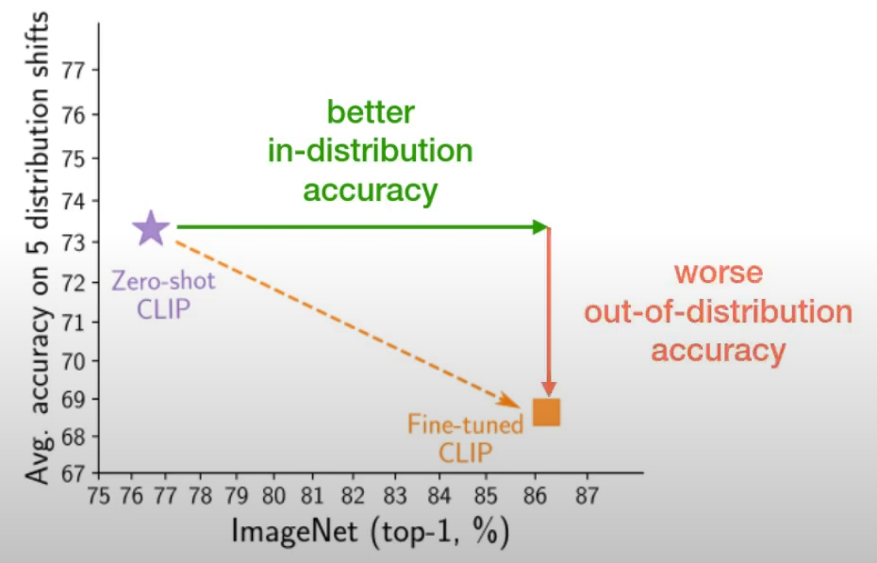
Background
Large pre-trained models such as CLIP [82], ALIGN [45] and BASIC [77] have recently demonstrated unprecedented robustness to challenging distribution shifts.
Since those models are trained on data collected from the web, they may not apply well to niche domains. → Let’s fine-tuning ... However there is a problem
Many paper said that “fine-tuning comes at the cost of robustness”
Across several natural distribution shifts, the accuracy of their fine-tuned models is lower than that of the original zero-shot model.
the question of robustly fine-tuning pre-trained models has recently also been raised as an open problem by several authors [3, 9, 82, 77].
Can zero-shot models be fine-tuned
without reducing accuracy under distribution shift?

Slide 3
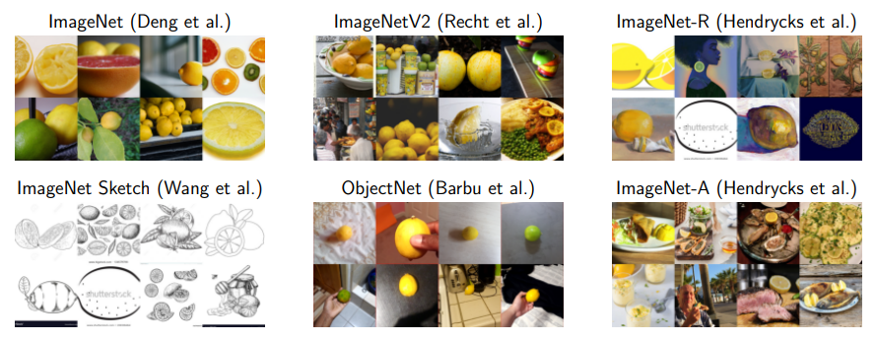
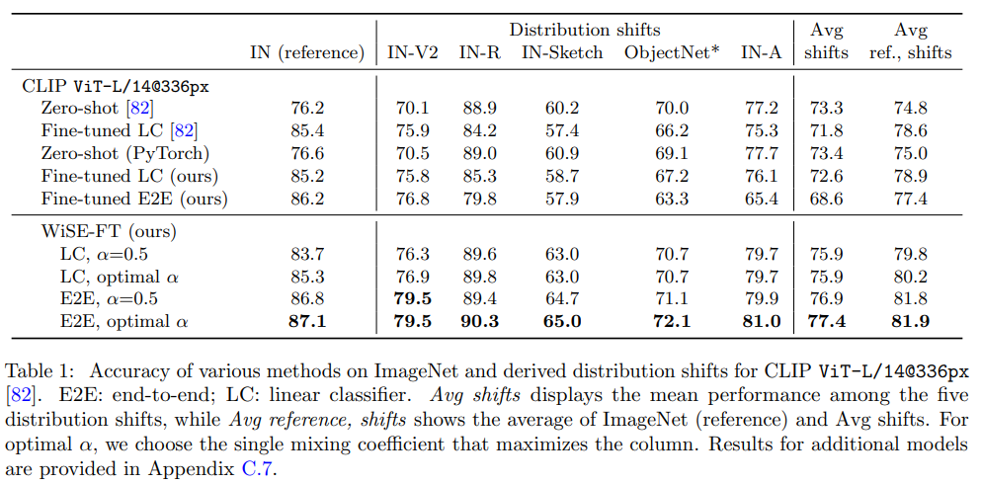
Contributions
Propose a robust way of fine-tuning zero-shot models that addresses the aforementioned trade-off => named “WiSE-FT”
Many Experiments for Evaluation:
ImageNet distribution shifts
reference domain for finetuning: ImageNet
Shift domain: ImageNetV2, ImageNet-R, ImageNet Sketch, ObjectNet, ImageNet-A
Another distribution shifts (appendix)
reference domain for finetuning: ImageNet
Shift domain: WILDS, CIFAR-10, ImageNet-Vid-Robust, YTBB-Robust
Beyond CLIP
Tested ALIGN, BASIC, ViT trained on JFT
Limitation
This paper’s discussion is only for image classification problem

Slide 4
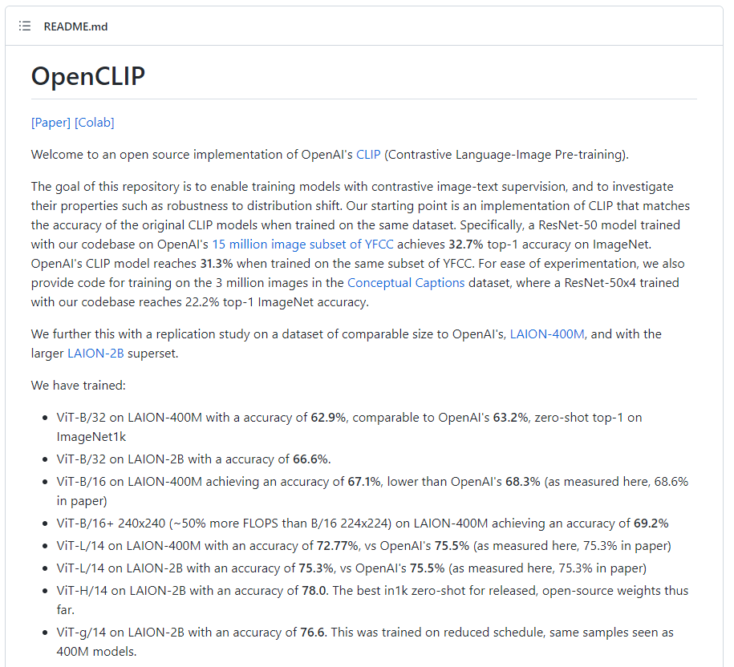
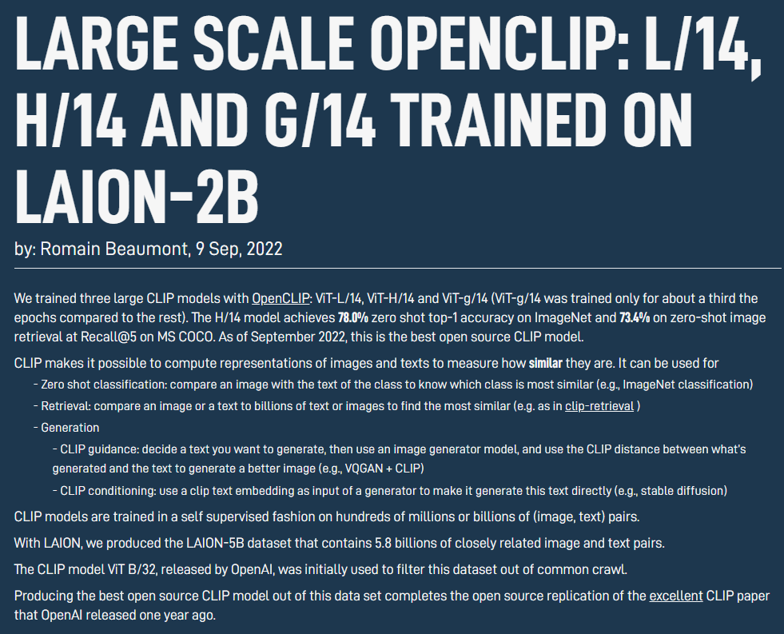
Contributions to Open CLIP
https://laion.ai/blog/large-openclip/
https://github.com/mlfoundations/open_clip

Slide 5
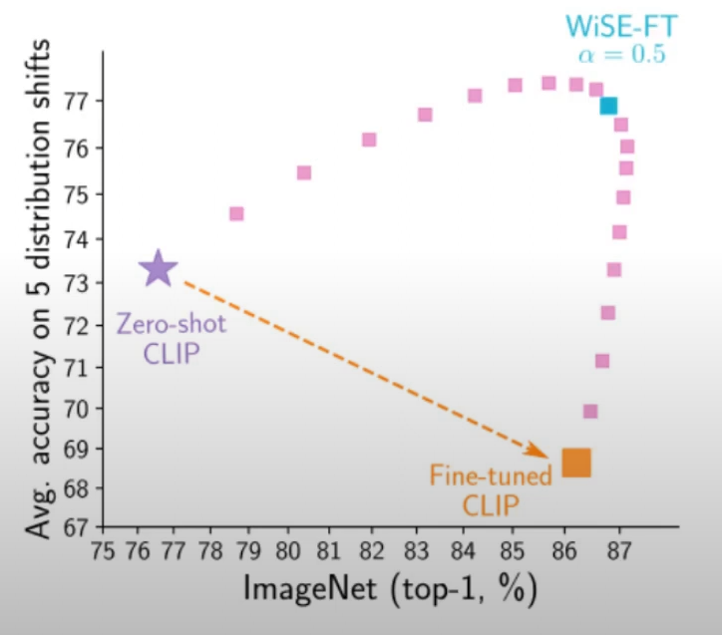

Proposed Method
Weight-space ensembles for fine-tuning (WiSE-FT)
Blend original and fine-tuned model parameters by α
WiSE-FT
model
Parameter
of original model
Parameter
of fine-tuned model
Just do it

Slide 6
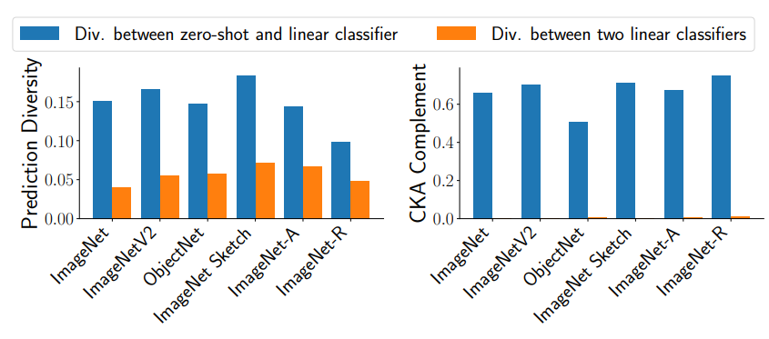
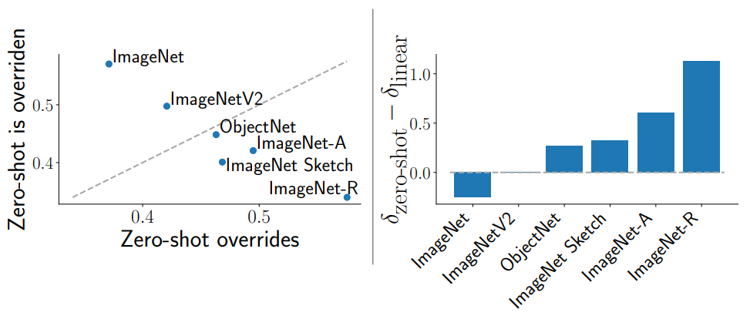
Why it works (observations)
About weight-space ensembles
Zero-shot and fine-tuned models are diverse even if the back-born models are same → The ensemble has a huge effect
Models are more confident where they excel
zero-shot model is more confident in its predictions under distribution shift, while the reverse is true on the reference distribution.

Slide 7
Why it works (Hypothesis)
Linear Mode Connectivity of Frankel[25] is observed when weight-space ensembles is done with models which
(1) part of the training trajectory is shared, or
(2) two models are fine-tuned with a shared initialization[73]
The fact that one model is a zero-shot model allows
this and the phenomenon described in [73] may have occurred…?

Slide 8
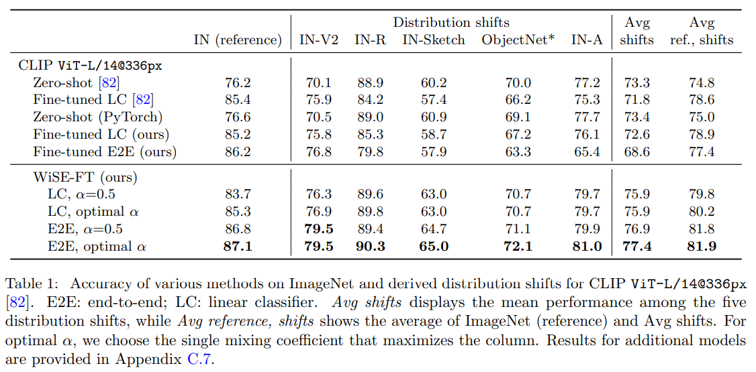
Experiments
For ImageNet Distribution Shift
Reference domain for finetuning: ImageNet
Shift domain: ImageNetV2, ImageNet-R, ImageNet Sketch, ObjectNet, ImageNet-A

Slide 9
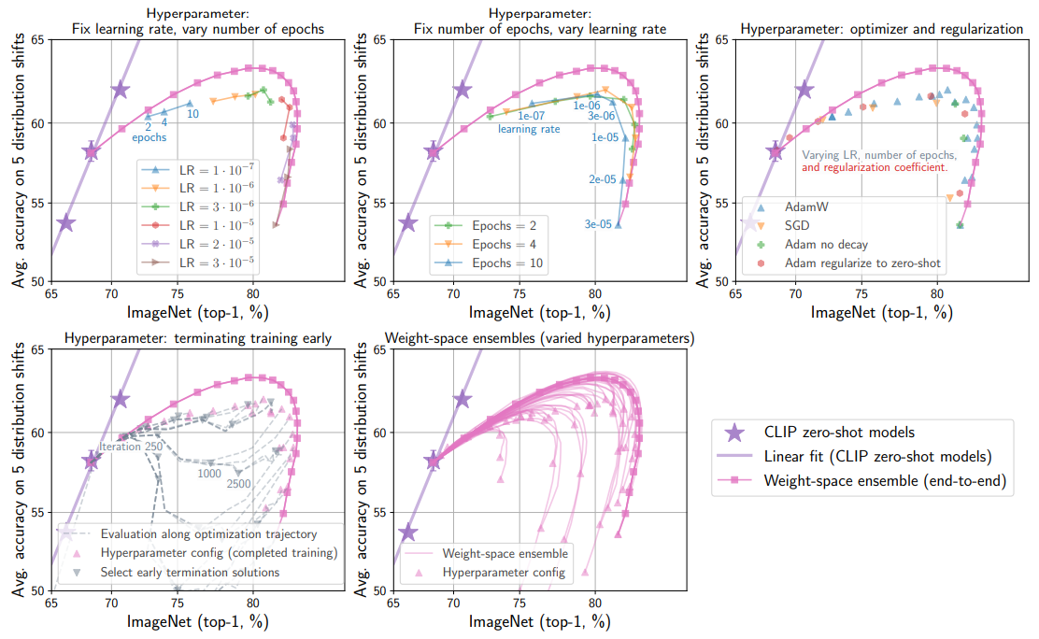
Experiments
The models which can be achieved by varying α are as good or better than those achievable by other hyperparameter configurations.

Slide 10
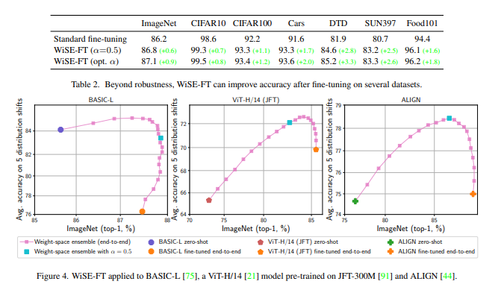
Experiments
WiSE-FT is generally applicable to zero-shot models beyond CLIP, and beyond models pre-trained contrastively with image-text pairs.

Slide 11
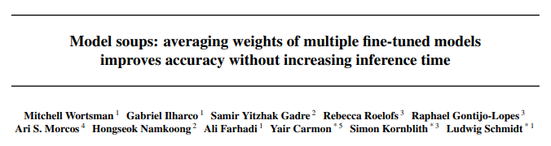
Conclusion
WiSE-FT can substantially improve performance under distribution shift with minimal or no loss in accuracy on the target distribution compared to standard fine-tuning. We view WiSE-FT as a first step towards more sophisticated fine-tuning schemes and anticipate that future work will continue to leverage the robustness of zero-shot models for building more reliable neural networks.
Same Author
At ICML’22

Slide 12
END

Slide 13
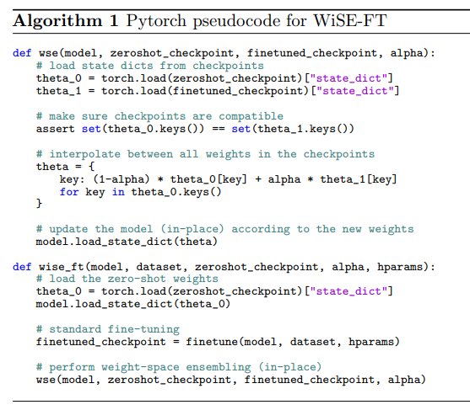
Pseudo code for WiSE-FT

Slide 14
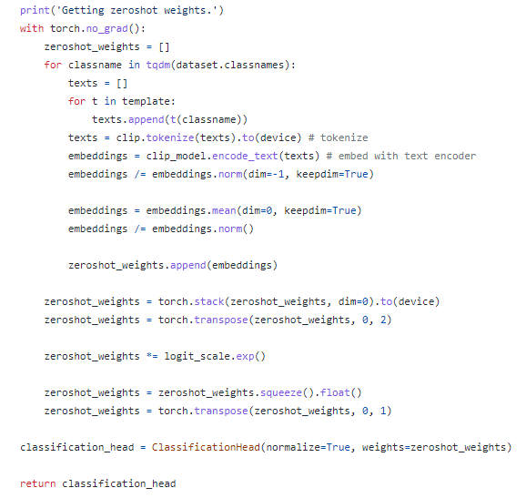
Classifier head

